Slide 1
Use Cases and Growth
Work so far, and next steps March 2024 Kieran Forde - Senior Content Designer

Slide 2
Purpose of this deck
Many people I have spoken to recently know that use cases exist, but there’s a lot of confusion about what they are and how we should use them.
I’m hoping this deck will:
Explain what use cases are and why they’re important
Share the work done so far
Show how use cases could help align our work across Growth
Explore the strategic content assets we can create to help teams harness and talk about use cases consistently
Note: this deck is a snapshot of the latest developments - it’s not intended to be an ongoing “source of truth”. Check out Starter Relaunch | Use Cases & Positioning | Atlas for ongoing updates.
Notes:
Use cases are a way to create aligned focus

Slide 3
What are use cases and why do they matter?

Slide 4
Context
“Driving usage” is one of our “Strategic Six” objectives for HubSpot in 2024
We’re focusing on usage because product data shows that when customers use HubSpot more, they grow faster and they are less likely to downgrade.

Slide 5
What are use cases?
Use cases capture the core value propositions of each hub.
They help us explain the specific ways that HubSpot can solve for our customers.
Here’s how Yamini explains this in her wiki post:
“As our product footprint has grown, it’s become harder to explain the problems HubSpot can solve for our customers. We’re going to simplify this by focusing on 2-3 core use cases that each Hub and the CRM platform solve. We will obsess over product usage against these use cases.

Slide 6
What are the use cases?
Correct on 7 March 2024 - See the latest customer platform positioning framework
Hub | Use Case
Marketing Hub | Generate leads
 | Automate marketing
Sales Hub | Build pipeline
 | Close deals
Service Hub | Scale support
 | Drive retention
Content Hub | Create content
 | Manage content
Operations Hub | Activate data
 | Manage data
Commerce Hub | Collect payments and subscriptions
 | Automate billing and invoicing
Ecosystem | Use Case
Smart CRM | Unify customer profiles
 | Unify teams
 | Unify tech stack
Marketplace | Find integrations, templates and services
Academy | Learn new skills, gain credentials
Network | Join our community, grow your craft

Slide 7
How will use cases be used?
Each use case has “value metrics” associated - these measure the outcomes a customer has achieved, and therefore how successfully they have used the product
HubSpot Leadership will monitor user satisfaction with our top use cases through CSAT scores
Product teams will use CSAT and usage metrics for use cases to understand when to take action, and how to improve value and usage
Marketing will focus on use cases for acquisition efforts on the website
Use cases will help us create consistent messaging and measurement - we’ll know we’re talking about the same things in the same ways, across Flywheel and Product teams (and even within Growth teams)

Slide 8
Recap
We’re focusing on usage because customers that use HubSpot grow faster and are less likely to downgrade
Use cases will help us drive usage by focusing our attention on the features that offer the most value to our customers
We’ll know if customers are getting value from use cases by monitoring usage metrics and customer satisfaction scores (CSAT)

Slide 9
What does this mean for Growth?

Slide 10
Growth use case priorities
We’ve prioritized the 10 use cases that are most relevant to our target audience of (mostly) Business Builders. We will focus these use cases for our Free/Starter relaunch in 2024.
Hub | Use Case
Marketing Hub | Generate leads
 | Automate marketing
Sales Hub | Build pipeline
 | Close deals
Service Hub | Scale support
 | Drive retention
Content Hub | Create content
 | Manage content
Operations Hub | Activate data
 | Manage data
Commerce Hub | Collect payments and subscriptions
 | Automate billing and invoicing
Connected ecosystem | Use Case
Smart CRM | Unified Customer Data
 | Customer intelligence
 | Customization and extensibility
Marketplace | Find integrations, templates and services
Academy | Learn new skills, gain credentials
Network | Join our community, grow your craft
Ecosystem | Use Case
Smart CRM | Unify customer profiles
 | Unify teams
 | Unify tech stack
Marketplace | Find integrations, templates and services
Academy | Learn new skills, gain credentials
Network | Join our community, grow your craft

Slide 11
What Growth projects could use cases affect?
Use cases create a great opportunity for us to align our customer-facing messaging across all Growth touch points, such as:
Marketing channels: HubSpot.com, Google Ads, TV ads, billboards
Signup
Microapps
Playbooks
CRM Templates and pre-configured accounts
User guides
Adoption Delivery System
Product-Led Growth

Slide 12
Why do we need consistent customer-facing language?
We need to quickly and clearly show how HubSpot will add value for users.
We’ll drive usage by clearly communicating how we’re going to solve for the customer and why that’s important to them. By using language that has been designed, tested and iterated, we can be confident we’re using messaging that impacts customer behaviour.

Slide 13
Why do we need consistent customer-facing language?
Consistency will help us reassure customers that they’re on the right path as they progress through signup, onboarding, using features, and upgrading.
It’s extra important that we follow this consistent thread through to the CSAT questions we ask - we need to be confident that users are clear which use cases they’re providing feedback about. This will give us more confidence in our product data.

Slide 14
Grouping and framing use cases

Slide 15
Free and Starter
Use Cases
Positioning pillar | Use Case
Find and build your audience | Unify customer profiles
 | Activate data
Grow sales and get paid faster | Create content
 | Automate marketing
 | Generate leads
 | Collect payments and subscriptions
 | Automate billing and invoicing
Understand and organize your customer data | Build pipeline
 | Close Deals
 | Scale support
Let’s zoom into those prioritized use cases we’re focusing on for the Free/Starter Relaunch in 2024. Note: there is still some movement around specific use cases as teams do their own planning to work on use cases - specific focus will be finalised soon.

Slide 16
Free and Starter
Use Cases
Positioning pillar | Use Case
Find and build your audience | Unify customer profiles
 | Activate data
Grow sales and get paid faster | Create content
 | Automate marketing
 | Generate leads
 | Collect payments and subscriptions
 | Automate billing and invoicing
Understand and organize your customer data | Build pipeline
 | Close Deals
 | Scale support
The labels we’re using for each use case reflect the way that we think about these features, inside HubSpot. They don’t necessarily reflect the concepts and requirements of the business builders we’re targeting in Growth.

Slide 17
Free and Starter
Use Cases
Copy snippets for Business Builders
Positioning pillar | Use Case | Copy snippets for Business Builders
Find and build your audience | Unify customer profiles | Organize and track contacts
 | Activate data | Automate business reporting
Grow sales and get paid faster | Create content | Generate content
 | Automate marketing | Automate marketing
 | Generate leads | Attract and convert customers
 | Collect payments and subscriptions | Get paid faster
 | Automate billing and invoicing | Simplify customer billing
Understand and organize your customer data | Build pipeline | Develop promising leads
 | Close Deals | Close more deals
 | Scale support | Scale customer support
I have developed copy snippets to more clearly match Business Builders’ needs when we talk about a use case.
This language was designed based on outputs of a workshop I ran with Flywheel and Growth teams, as well as other Growth documentation.

Slide 18
Free and Starter
Use Cases
Features
Positioning pillar | Use Case | Key Feature/s*
Understand and organize customer data | Unify customer profiles | Smart CRM CRM Records, contact and company management, custom properties
 | Activate data | Reporting tools Marketing Reporting, Sales Reporting
Find and reach customers | Create content | AI Content and AI Website Builders AI Content (Topics, Blogs, Images, Content Assistant), AI Website Builder (Site pages, themes, hosting, website analytics)
 | Automate marketing | Lead Generation & Conversion Tools Forms, Landing Pages, Ads, CTAs**
 | Generate leads | Marketing Automation Tools Marketing Email, Lists, Contextual Automation
Grow sales and get paid | Build pipeline | Prospecting tools Sales Email, Templates, Calling**, Meetings, Quotes
 | Close Deals | Managing Deals Deals, Deal Board
 | Scale support | Customer experience tools Tickets, Conversations, AI Support Bots*, support phone number**
 | Collect payments and subscriptions | Payment processing Native payment links, subscriptions, Stripe integration*, Payments Workflows
 | Automate billing and invoicing | Billing and invoicing tools Product library, quotes, invoices, eSignature**, Quickbooks integration**
Each use case has specific features mapped to it.
We’ll measure if a user is finding value from a use case value based on how they use these features, and the CSAT scores for these features.
Note: the features that apply to each use case are still being mapped by Prod Ops, so may change.

Slide 19
Free and Starter
Use Cases
Positioning
Positioning pillar | Use Case | Key Feature/s*
Understand and organize customer data | Unify customer profiles | Smart CRM CRM Records, contact and company management, custom properties
 | Activate data | Reporting tools Marketing Reporting, Sales Reporting
Find and reach customers | Create content | AI Content and AI Website Builders AI Content (Topics, Blogs, Images, Content Assistant), AI Website Builder (Site pages, themes, hosting, website analytics)
 | Automate marketing | Lead Generation & Conversion Tools Forms, Landing Pages, Ads, CTAs**
 | Generate leads | Marketing Automation Tools Marketing Email, Lists, Contextual Automation
Grow sales and get paid | Collect payments and subscriptions | Prospecting tools Sales Email, Templates, Calling**, Meetings, Quotes
 | Automate billing and invoicing | Managing Deals Deals, Deal Board
 | Build pipeline | Customer experience tools Tickets, Conversations, AI Support Bots*, support phone number**
 | Close Deals | Payment processing Native payment links, subscriptions, Stripe integration*, Payments Workflows
 | Scale support | Billing and invoicing tools Product library, quotes, invoices, eSignature**, Quickbooks integration**
For the relaunch, each use case is mapped to a “positioning pillar”. These pillars have been developed by Product Marketing.
Positioning outlines why our product is unique, and how we provide value for customers.

Slide 20
How can we use use cases in future?

Slide 21
Recommendation:
Develop a framework for use case content
We will be able to work more coherently in Growth if we develop a content framework to document the language we should use anywhere a business builder encounters a use case - whether in HubSpot or through our marketing channels.
The framework will document snippets that make it easy to for us talk to users about use cases consistently, along with guidance teams can use when we need to create new content to use in different contexts.
The framework development should be led by Content Designers from the central team, with close involvement from Product Designers across Growth teams.

Slide 22
A quick clarification
The next few slides look at how use cases could fit into a few of the Growth projects we’ve worked on recently.
I’ll use very high-level example content and design to get the idea across and start the conversation.
Everything can and should be adapted by the teams working on these projects!

Slide 23
What could the framework look like?
Use case and value props
The “federal” use case
How this relates to Business Builders
How the use case adds value
How to use this content
Use Case | Use case copy snippets for Business Builders | Core value proposition copy snippets* | Guidance*
Generate leads | Attract and convert customers | Reach new customers and automate followups. Grow your list of people who want to buy from you. Capture website visitors and engage them by generating effective, targeted content. Convert contacts when you’re confident that they’re ready to buy. | Focus on how HubSpot simplifies lead generation by automating repetitive tasks. Generative AI can help scale and target lead generation to make it more effective. Connect the value props to specific features where appropriate.
*These are just examples - lots more work required to develop the right value props and guidance!

Slide 24
What could the framework look like?
Feature-level
The “federal” use case
How to achieve your use case
How we talk about getting this done
How to use this content
Use Case | Feature | Feature value proposition copy snippets* | Guidance*
Generate leads | Forms | Create professional-looking forms to convert website visitors into leads | Focus on ease and automation. Where possible, put forms in the context of the broader Lead Gen journey.
 |  | Gather customer insights from form submissions with ease
 |  | Build smarter forms with automated follow-ups based on what leads share with you
 | Landing pages | Create landing pages from templates that represent your brand | Give reassurance that minimizes the technical part of creating web pages.
 |  | Get found online with pages optimized for search engines, so visitors can find your content
*These are just examples - lots more work required to develop the right value props and guidance!

Slide 25
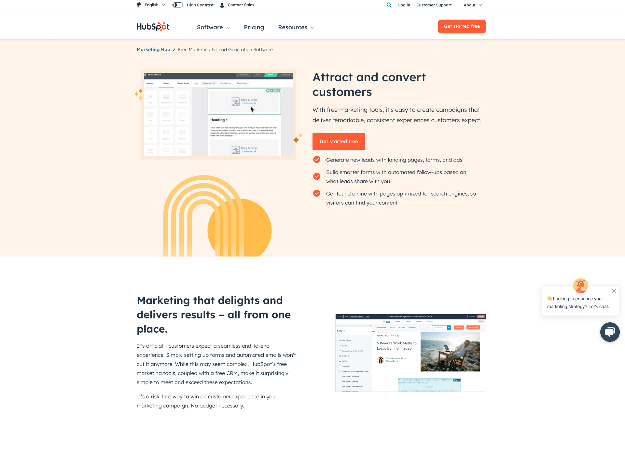
What could this look like? Hubspot.com - concept landing page for the Lead Gen use case
Use case snippet (Lead Gen)
Content informed by guidance
Feature snippets

Slide 26
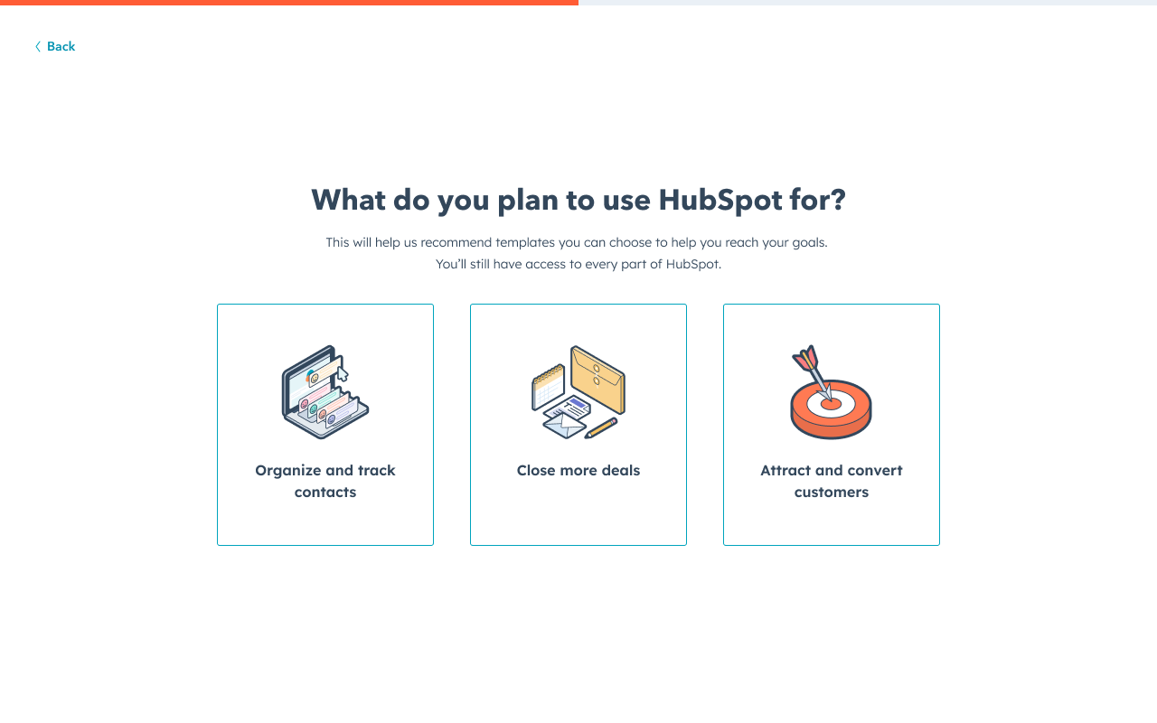
What could this look like? Signup
Use case snippet (Lead Gen)

Slide 27
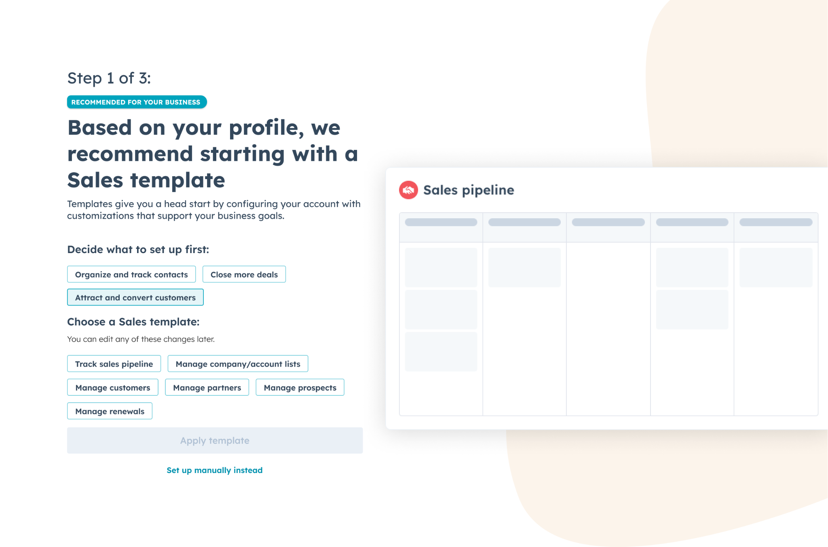
What could this look like? Templates
Use case snippets
Templates are relevant to use cases and associated features

Slide 28
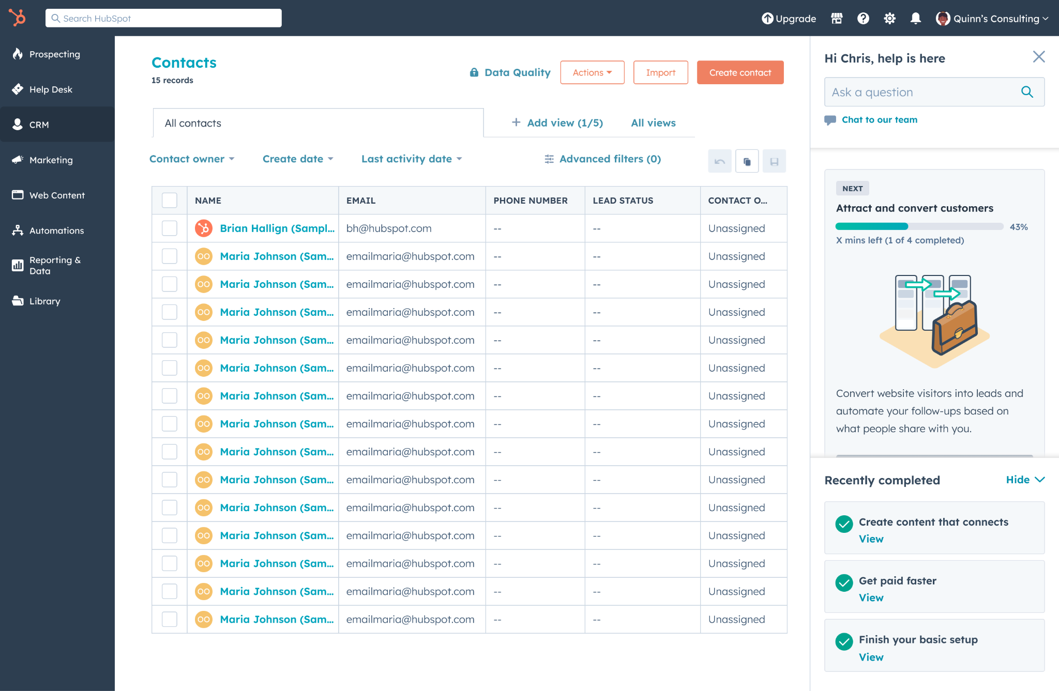
What could this look like? Delivery system
Here, we’re creating bespoke content using guidance from the framework - it’s important that teams have flexibility to adapt that guidance to focus on what’s important at any given stage of the journey.
Use case snippets
Bespoke content, based guidance

Slide 29
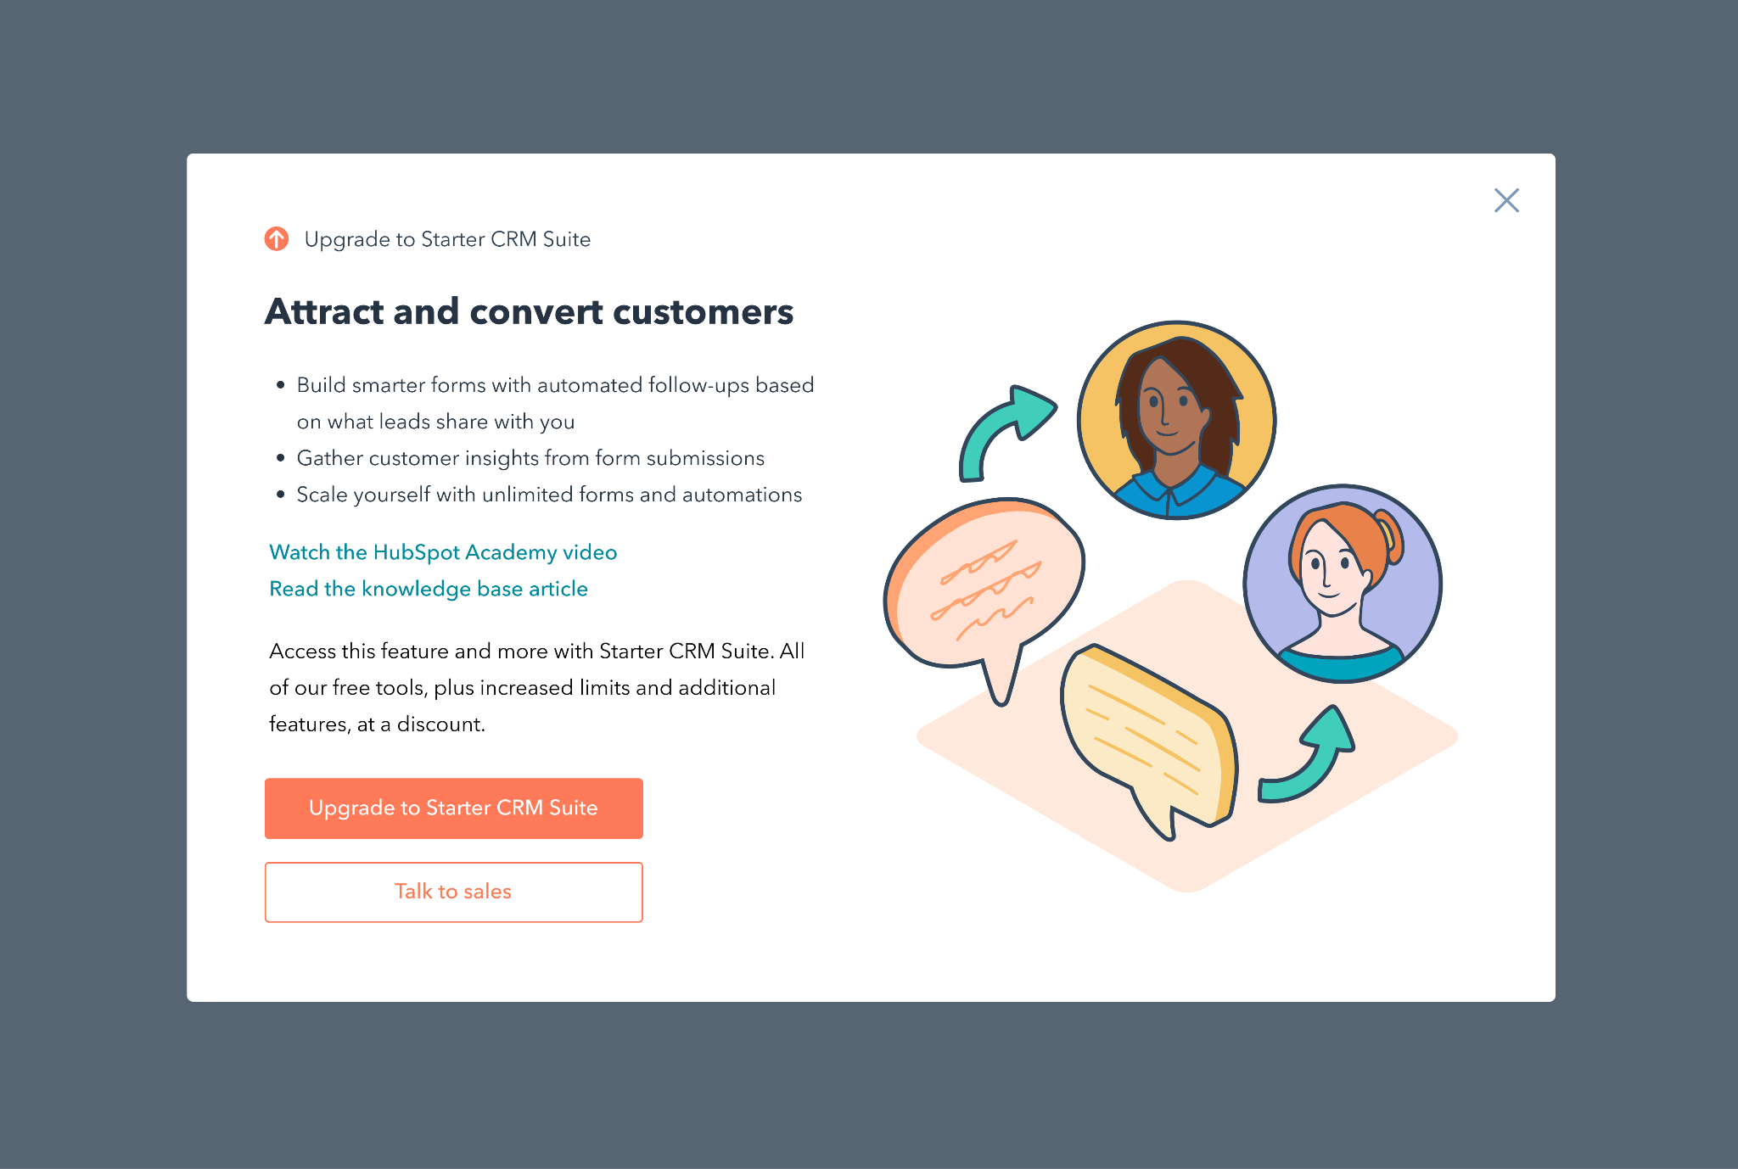
What could this look like? Product-led growth
Use case snippet (Lead Gen)
Features and value props
Business Builder framing on the use case

Slide 30
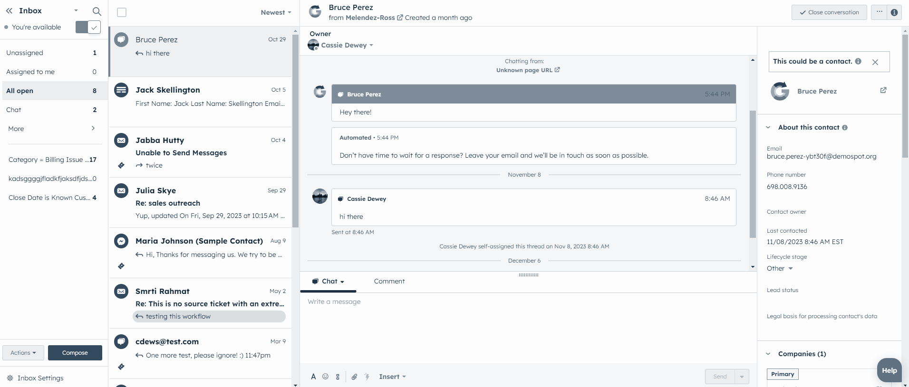
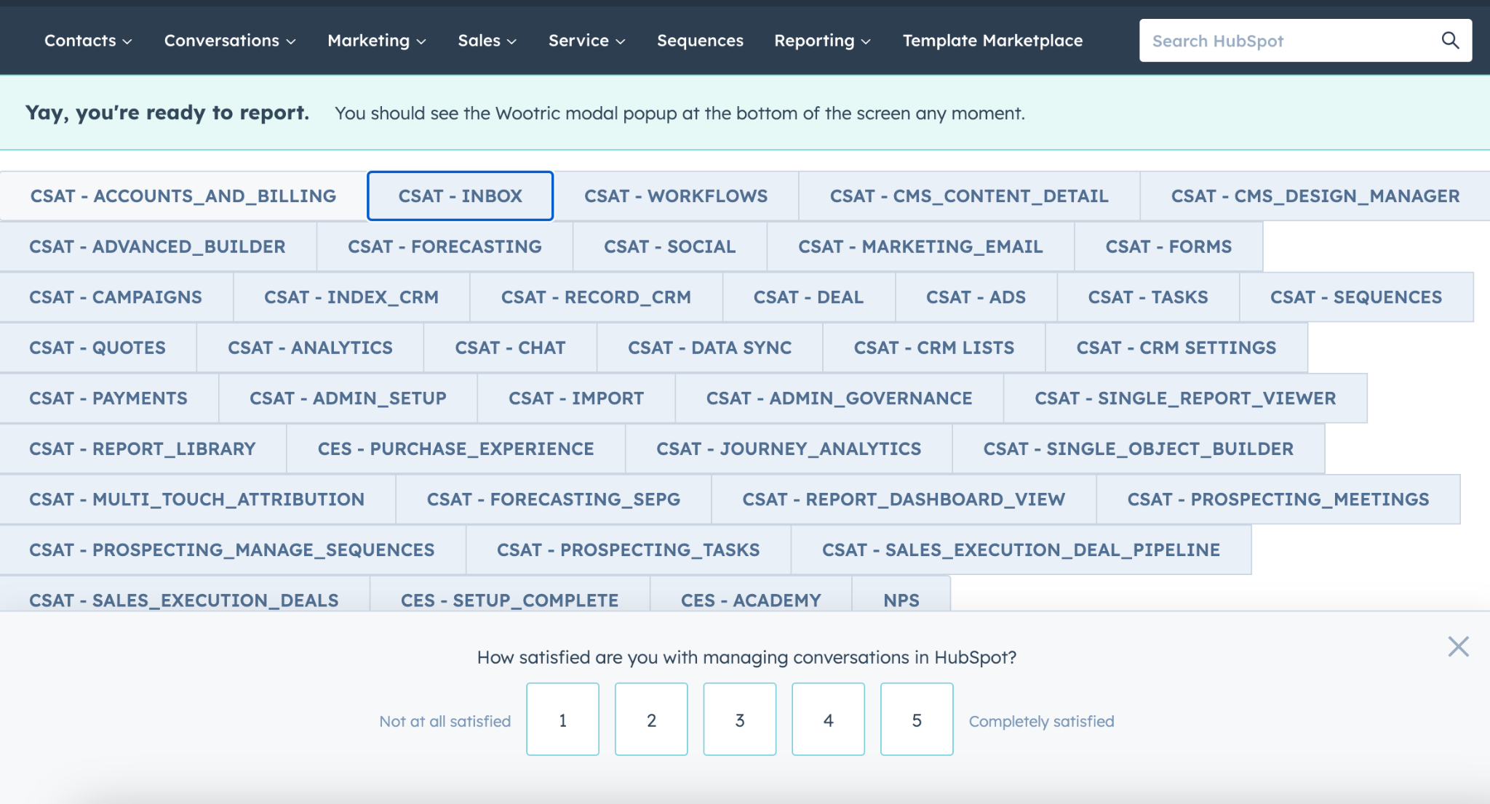
What could this look like? Customer satisfaction
Question frames use case with the same language used throughout the customer journey
How satisfied are you with how HubSpot helps you attract customers?

Slide 31
Use cases across the customer journey
Consistent language from Website > Signup > Onboarding > Upgrade > CSAT
How satisfied are you with organizing and tracking contacts in HubSpot?

Slide 32
Things to explore
Before we start developing the content framework, here are some areas I’d love to get teams’ feedback on:
Do we need to group use cases in categories?
For example are the positioning pillars helpful? Is more it useful to group use cases by Hub (provided we frame them from a user perspective - “don’t ship the org chart”!)? How and where would we use this kind of grouping?
How might we adapt use case language through the user/buyer journey?
We should avoid repetition by progressively building our messaging. Value props should be specific to what people are looking for at a given point in their journey.
What does the user journey look like for each use case?
For example, if someone signs up for the “Get paid faster” use case, should the first thing they see in onboarding cover the technical details of setting up payments, or a broader introduction to the platform?
Is it more helpful for the framework to contain specific snippets for many situations, or to give guidance that teams can apply themselves?

Slide 33
Things to explore
Before we start developing the content framework, here are some areas I’d love to get teams’ feedback on:
How might we reflect value HubSpot offers that’s not specifically tied to a use case?
AI, process automation, community, and delightful onboarding are good examples of things that we need to find a consistent way to showcase, but are more likely to apply to many use cases than be a specific thing that users are looking for. Do we need to find consistent ways to talk about these things too?
Is it helpful to create different content snippets for features at free and paid levels?
We don’t want to undersell the product by limiting ourselves to free features, but need to manage expectations about the free version
How might we use AI to make our language and feature suggestion more specific to what a user is most interested in?

Slide 34
What next?
Here are the things I am planning to do next, with input and support from Growth teams:
Develop a use case content framework to articulate user-facing language, reusable snippets, and guidance for all use cases and features
Leverage existing content assets, such as the User Guide Pattern Consolidation: Content Strategy and upgrade modal library to expand the coverage of the framework
There are a few areas where I will need more help from others:
Map use cases to the “objects” we’re creating across Growth workstreams (templates, playbooks, upgrade modals, etc) so that we can better understand how we will align customer journeys around use cases
Harness the Free & Starter Relaunch workstreams to roll out consistent user-facing language:
The positioning and content working group would be consulted to ensure alignment between Marketing and Product
The end-to-end-experience working group would be responsible for rolling out the new content and ensuring consistency

Slide 35
Free and Starter
Use Cases
Copy snippets for Business Builders
Use Case | V1 | V2 | Signup
Unify customer profiles | Organize and track contacts.
Create content | Create and optimize content | Generate content | Create marketing content
 |  |  | Build websites and landing pages
Automate marketing | Create targeted marketing content with AI | Automate marketing | Automate marketing
Generate leads | Attract and convert customers |  | Generate leads
Collect payments and subscriptions | Get paid faster |  | Send bills and collect payments
Automate billing and invoicing | Simplify customer billing
Build pipeline | Develop promising leads |  | Grow and manage sales pipeline
Close Deals | Close more deals
Scale support | Give customers the support they need |  | Scale customer support

